Slide 1
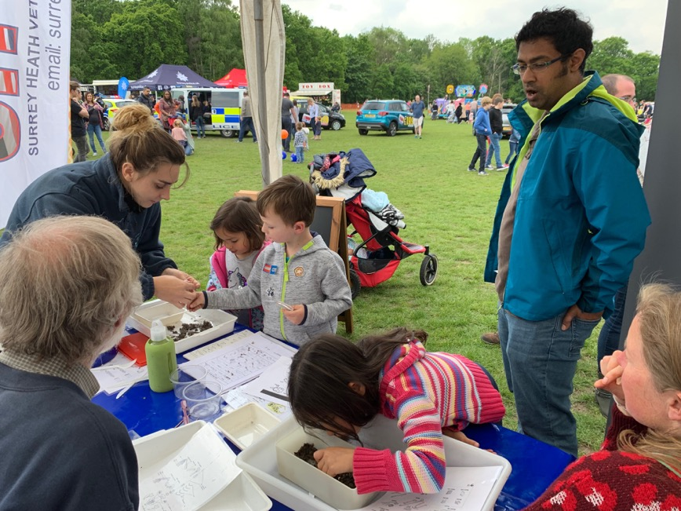
Business Plan
2019/2020
Blackwater Valley Countryside Trust
Ash Lock Cottage, Government Road, Aldershot, Hampshire GU11 2PS
Company registered in England No. 04898996 Registered Charity No. 1109424

Slide 2
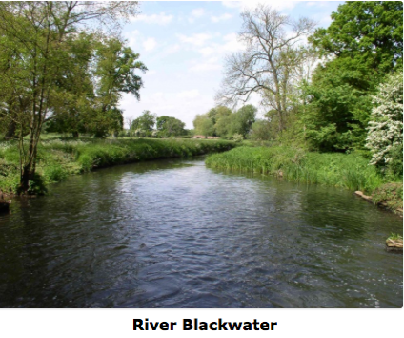
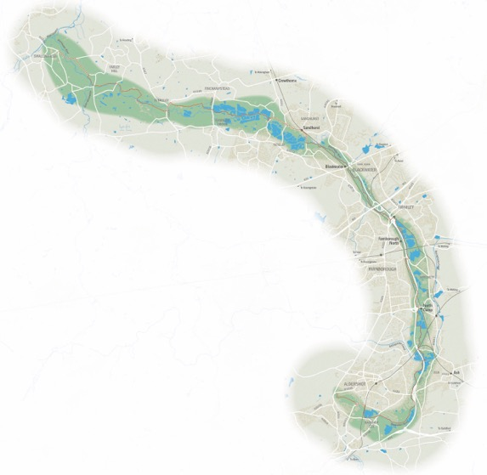
About the Blackwater Valley
The Blackwater Valley stretches from Rowhill on the Hampshire and Surrey border, to Swallowfield in Berkshire. After rising at Rowhill Copse, the river joins the Whitewater 23 miles later, becoming the Broadwater.
It has a surprisingly varied landscape rich in wildlife, and the shallow floodplain along the river, set amidst extensive heathlands and woodlands, contains many lakes and wet meadows created by many years of gravel and sand extraction.
The Blackwater / Cove water catchment area covers 16,000ha. The upper (southern) end of the Valley has been heavily influenced by urbanisation, with the settlements of Yateley, Blackwater, Farnborough, Aldershot, Weybourne, Badshot Lea, Ash, Mytchett, Frimley, Camberley, and Sandhurst creating a near continuous built area surrounding the River Blackwater covering 5,500 ha.
According to the 2011 census, almost 800,000 people were living within easy reach of this area. In addition, there are numerous businesses, military, educational establishments and leisure facilities that people travel to from within and outside of the Valley. We estimate that approximately 1 million people have a connection to the Valley.

Slide 3
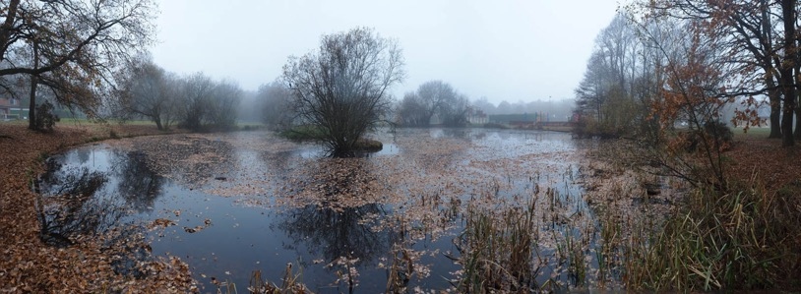
Our History and Objectives
Our Charitable Objectives
to promote the conservation, protection and improvement of the physical and natural environment and promote the management of the countryside, biodiversity and wildlife habits and characteristic landscapes of the Blackwater valley by supporting conservation projects and programmes within and around the boroughs of Rushmoor, Bracknell Forest, Guildford, Waverley and Surrey Heath; the districts of Hart and Wokingham and such other areas as the charity may from time to time decide ('the area of benefit’) and
to advance the education of the public on matters connected with the countryside management by supporting, promoting and improving public access to countryside, and promoting the participation of the public in countryside management within the area of benefit.
History
Our Trust was founded by enthusiasts who care about the people and wildlife of the Blackwater Valley. It was incorporated as a company in 2003 and as a charity in 2005.
In its first 14 years of operation, it has enabled wildlife friendly projects with a value over £200,000 to be completed in the Blackwater Valley.
The Trust is private company limited by guarantee without shares. It is registered in England and Wales under company number 04898996.
It is also a registered charity under registration number 1109424.

Slide 4
Our Trustees and Management Team
Our trustees and management team use their wide range of backgrounds and specialist skills to help conserve and improve the natural environment of the Blackwater Valley. Other volunteers include Mike Swaddling (marketing).
Annie Keighley
Membership Secretary
Position Vacant
Marketing Manager
Position vacant
Events Manager
Sharon
Atchley
Webmaster
Steve Bailey
Company Secretary
Jenny Simmonds Fundraising
Mary Ferriss
Chair
Colin Wilson Vice Chair
Shelagh Heasley
Treasurer
Alan Taylor
Projects and Grants
Bernard Baverstock
Wildlife Advisor
Simon Weeks
Trustee
Chris Smith
Trustee

Slide 5
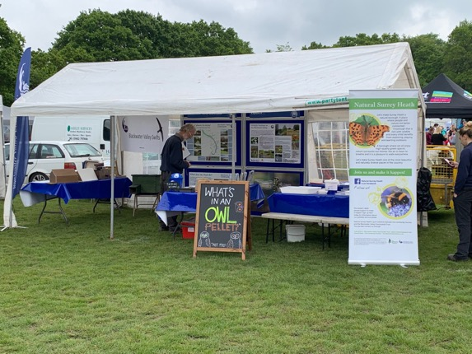
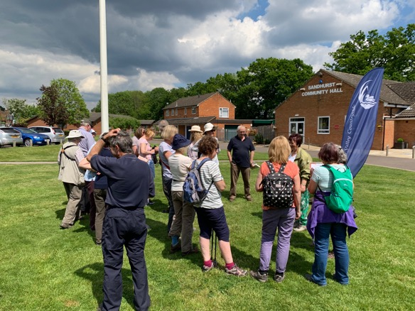
Our Values, Vision and Mission
Our values
We believe in equality, respect, caring and sharing, always remembering wildlife has an equal right to live on Earth as we do.
Our Vision
Our vision is a Blackwater Valley rich in native wildlife where inhabitants and visitors share the Valley harmoniously and respectfully with other species which live in it.
Our Mission
Our mission is to use our skills and resources to make the Blackwater Valley a special place, full of life and accessible to all, where the countryside is valued and the people and wildlife thrive together. We will do this by engaging local people and businesses in nature and conservation activities and show them the purpose and benefits of our work.

Slide 6
Our Aims
We aim to:
Enhance the environment for both people and wildlife by:
promoting public access to the countryside by means of a programme of events, including walks and talks
Help inform people about their Valley and the wildlife on their doorstep
identifying improvement ideas, creating projects and raising funds to progress them
encouraging a sharing of knowledge and a sense of belonging in the Blackwater Valley.

Slide 7
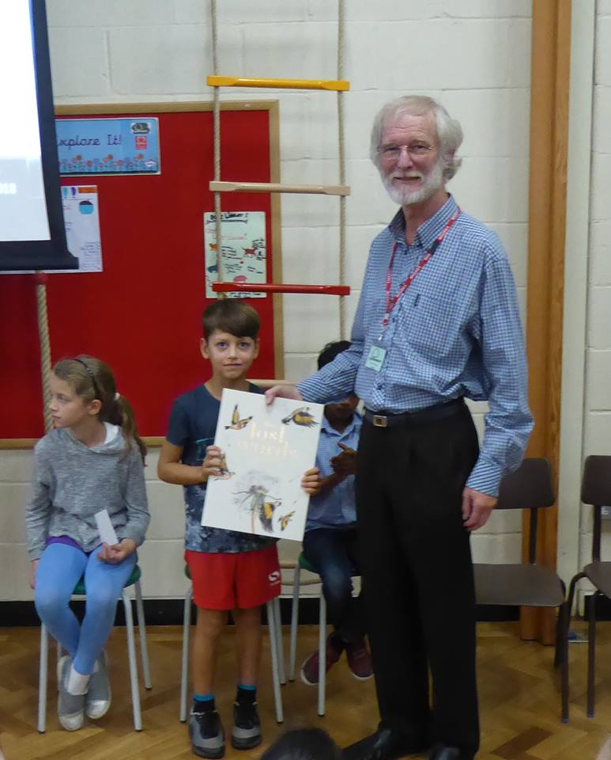
Our Activities
We offer membership to households, businesses and associate groups with similar aims. This provides an opportunity to support or contribute to the Trust’s work, the option to attend our events such as walks and talks offered by the Trust and regular newsletters.
We help manage pockets of the Valley’s countryside and preserve its wildlife habitats by making conservation projects happen.
We provide consultancy and advice and deliver projects to benefit wildlife and are constantly looking for opportunities to create more in the Blackwater Valley.
We provide grants to third parties for projects consistent with the aims of the Trust.
We seek to enhance our relationships with businesses to assist them with environmental aspects of their corporate social responsibility plans and aims to develop these over time.
We educate the public about the natural world and the local environment.

Slide 8
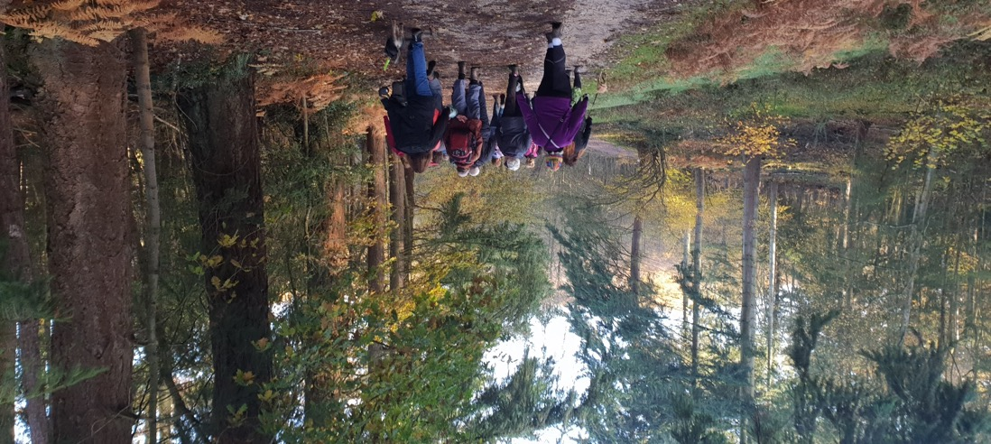
Our Beneficiaries and Customers
Beneficiaries: Beneficiaries of our work are at the heart of everything we do and are all the wild things that grow, or could grow, in the Valley. The Trust provides provide services to them by conserving them and encouraging them to grow here. To do this, the Trust attracts members and gains their support for its objectives. Other beneficiaries are users and inhabitants of the Blackwater Valley
Customers: Our members are our customers and we provide services which our members value. These people and businesses are the Trust’s donors and supporters, alongside grant-making bodies and sources of funds approached by the Trust from time to time.

Slide 9
Our Members, Donors and Supporters
These are individual and corporate members and donors at events, together with grant-making bodies and sources of funds approached by the Trust from time to time.
We recognise that our members and supporters are essential and appreciate that they are key to our continued success. We inspire and enable everyone to do their bit – because the challenge of conserving our natural environment in the valley is too big to overcome alone.
The membership figures as at 30th September 2019 were:
295 Households*
9 Affiliated Groups
5 Corporate and Associate members
3 Honorary and Life members
Total 312.
*As each individual membership is assigned to an address or household which may have more than one person living there, the number of actual individuals covered by membership is materially higher.
We have a new Membership Secretary, Annie Keighley. Membership recruitment is a priority for 2019/20.
We are also working hard to attract more corporate members and sponsorship and donations. So far, we are pleased to announce that in 2019, we have attracted sponsorship from Kebur, Farnborough Airport, Fluor, S C Johnson and Touchstone Energy.

Slide 10
Our Partners, Suppliers & Relationships
Suppliers and Partners
We have a preferred supplier for most of our projects. The supplier is Blackwater Valley Countryside Partnership which, apart from detailed geographical and environmental knowledge of the Valley, has good access to land there. BVCP staff also have wildlife conservation skills and experience, a broad range of contacts and the necessary tools, equipment and skills to undertake work. If we are unable to use BVCP for support or work, we tender work to third parties to ensure value.
We will partner with other organisations where necessary to offer projects and services, e.g. the Camberley Society were our joint partners for the Natural Surrey Heath Project (The Society has now been wound up). In 2019 we worked with Community Rail Partnership on our ‘Rail to Trail’ project.
Primary Relationships: We work closely with other organisations who support our objectives including:
the Blackwater Valley Countryside Partnership
county and local authorities
local groups with similar interests
corporate donors.

Slide 11
Our Compliance, Insurance and Ethics
Compliance
We comply with the requirements of relevant legislation.
We ensure our activities and spending are in line with our governing document and are undertaken in accordance with the public benefit requirement for charities.
We comply with our contractual obligations to suppliers and others, including its insurers, its bank, etc.
We maintain accurate and secure financial records and information to ensure compliance with its fiscal and accounting obligations.
Insurance
We maintain adequate public liability insurance to cover our activities and our officers and members. This is regularly reviewed to ensure it remains adequate and relevant.
Ethical Principles
We are members of The National Council for Voluntary Organisations and uphold their Ethical Principles which aim to support charities, their governing bodies, and those who work and volunteer in and with them in recognising and resolving ethical issues and conflicts, and make charities a safer place.

Slide 12
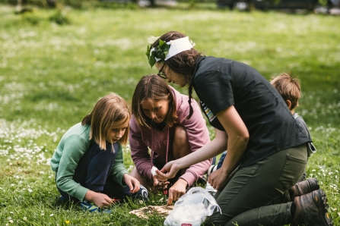
Planning our Year- Projects and Activities
We need to undertake and support our own and other projects to meet our objectives.
Our priority plan for 2020 includes the following projects or activities:
Strengthen and expand the management team
Developing and launching a project to educate children about nature - NatureHunt
continuing Woodland Flowers project
continuing Saving our Amazing Swifts project
Launching our Rail to Trail partnership with Community Rail Partnership
Small Grants Scheme
complete policies and procedures review
increase household and business Memberships
Review funding options with BVCP

Slide 13
Planning our Year- Fundraising
Our programme for 2019/20 involves costs amounting to approximately £20,834.
We will raise funds to pay for these by:
household membership, subscriptions, donations and Gift Aid
business (corporate) membership and donations
donations from various sources, for talks, events such as Big Valley Ramble
grants from Businesses and Funding bodies (many already received)
fundraising e.g. lottery participation, recycling inkjet cartridges, selling bird, dormouse boxes, etc.

Slide 14
Planning our Year- Activities Programme
We cannot succeed without our Members. We provide a programme of activities in return for their support.
Our full programme is evolving and is published at www.BVCT.org.uk/events and on our Facebook page. Highlights include:
our AGM on 13th February
10 monthly guided walks
Our launch of ‘Rail to Trail’ in March
Big Valley Ramble on 26th April
Opportunities to join work parties in the Valley
A variety of walks to find nature in the valley
Attendance at various fetes and fairs and
Walk off the Christmas Pudding walk.

